Slide 1


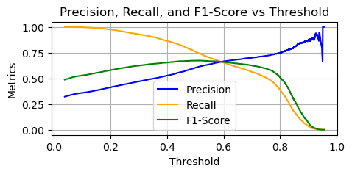
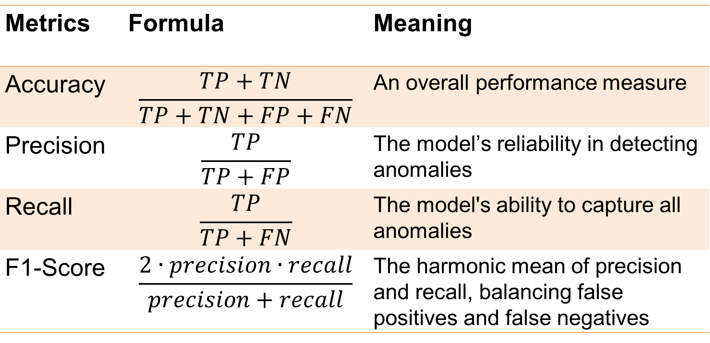
Using Machine Learning to Identify Anomalous Activities
for Data Leakage Detection
Sheng-Chun Lim and Hunter Paul
Computer Science Department
San Diego State University
Introduction
Approach
Results
Data leakage has become a critical concern for modern organizations, posing risks such as financial losses, reputational damage, and legal liabilities. The consequences of exposing sensitive information can be severe and far-reaching. With the increasing reliance on digital systems and the rapid growth of data, there is an urgent need for efficient and accurate methods to detect data leakage.
This research aims to investigate the effectiveness of machine learning techniques in identifying data leakage by focusing on anomaly detection in user activities within a computer network or system.
Data Preprocessing
Model Performance on the test dataset
Data Cleaning
Remove missing data (12%)
Feature Extraction
Extract13 features from 17 columns using principal component analysis (PCA)
Train-Test Split
80% for training set, 20% for testing set
Data Transformation
Transform categorical features into one-hot encoded
Transform datetime data into seconds
 | Accuracy | Precision | Recall | F1-Score
Isolation Forest | .63 | .59 | .63 | .61
Autoencoder | .67 | .56 | .67 | .57
Logistic Regression | .70 | .67 | .70 | .67
Decision Tree | .69 | .69 | .69 | .69
Random Forest | .77 | .76 | .77 | .76
SVM | .72 | .76 | .72 | .73
XGBoost | .77 | .77 | .77 | .77
Models
Background
Unsupervised Learning
Logistic Regression
Decision Tree
Semi-Supervised Learning
Supervised Learning
Isolation Forest
Autoencoder
Random Forest
Support Vector Machine (SVM)
XGBoost
Detect anomalies by isolating data points in a high-dimensional space
Anomaly detection techniques have traditionally focused on single paradigms, such as unsupervised learning. Semi-supervised and supervised methods are often underutilized in the context of data leakage detection.
Lack of comprehensive studies that explore diverse machine learning paradigms for anomaly detection
Learn to reconstruct normal patterns and flag deviations as anomalies
A generalized linear model that predicts the probability of a binary outcome based on input features
A hierarchical model that splits data into branches based on feature thresholds to classify or predict outcomes
Dataset
An ensemble method using multiple decision trees to improve accuracy and reduce overfitting
Finds an optimal hyperplane to classify data points, particularly effective in high-dimensional spaces
Data Leakage Detection Dataset from Kaggle
The dataset captures various aspects of user interactions with the system and the presence of abnormalities in user behavior
49,500 records x 15 columns (43,560 records x 11 columns are used)
An efficient gradient-boosting algorithm designed for speed and performance
Figure. Precision/Recal/F1 Curve of XGBoost Model on training set
The optimal threshold was determined at the "golden cross"−the point where precision equals recall, which is 0.5919.
All models were tuned using 10-fold cross-validation to optimize hyperparameters.
Conclusions
Activity Info
Authority levels*
Activity timing+
Authentication methods
Password
PIN
Actions
File transfer
File operation*
Data sensitivity*
Multi-Factor Authentication (MFA)
Data modification
Confidential data access
External interactions
Target variable
Abnormality (31% are abnormal)
Model Evaluation
Key Findings:
XGBoost demonstrated the best performance, making it the most suitable for anomaly detection for data leaks in the given dataset
Future Work:
Integrate models into real-time monitoring systems
Explore ensemble methods combining the strengths of multiple paradigms
Metrics | Formula | Meaning
Accuracy | $$\frac{TP+TN}{TP+TN+FP+FN}$$ | An overall performance measure
Precision | $$\frac{TP}{TP+FP}$$ | The model’s reliability in detecting anomalies
Recall | $$\frac{TP}{TP+FN}$$ | The model's ability to capture all anomalies
F1-Score | $$\frac{2∙precision∙recall}{precision+recall}$$ | The harmonic mean of precision and recall, balancing false positives and false negatives
References
All variables are binary, except for:
* Categorical variables + Continuous variables
Nassif, A. B., Talib, M. A., Nasir, Q., Albadani, H., & Dakalbab, F. M. (2021). Machine learning for cloud security: a systematic review. IEEE Access, 9, 20717-20735.
Naseer, S., Saleem, Y., Khalid, S., Bashir, M. K., Han, J., Iqbal, M. M., & Han, K. (2018). Enhanced network anomaly detection based on deep neural networks. IEEE access, 6, 48231-48246.

